Slide 1
Elastic Event Platform
A Scalable and Fault-Tolerant Cloud-Based Event Management Solution

Slide 2
Team Members
Name | Roll Number
Prateek Singhal | M22AIE215
Aryan Kumar | M23CSA510
Harsh Parashar | M22AIE210

Slide 3
Agenda
Overview of Event Manager Application
Scenarios (Use Case View)
Architecture
Architecture Pattern
Class Diagram
Process Flow
Cloud Computing Focus Areas

Slide 4
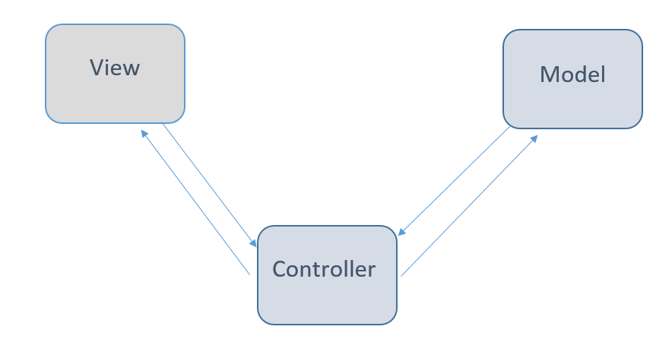
Overview of Event Manager Application
Key Features
Architecture Style
Model-View-Controller (MVC)
Manage events
Ticket booking and payment processing
User registration
Technologies
FastAPI for web framework
PostgreSQL for database
Asynchronous programming with asyncio
Deployed on Google Cloud Platform (GCP)

Slide 5





Scenarios (Use Case View)
User Registration
Event Management (Admin User)
Event Browsing (Normal Users)
Ticket Booking (Normal User)
Payment Processing (Normal User)

Slide 6
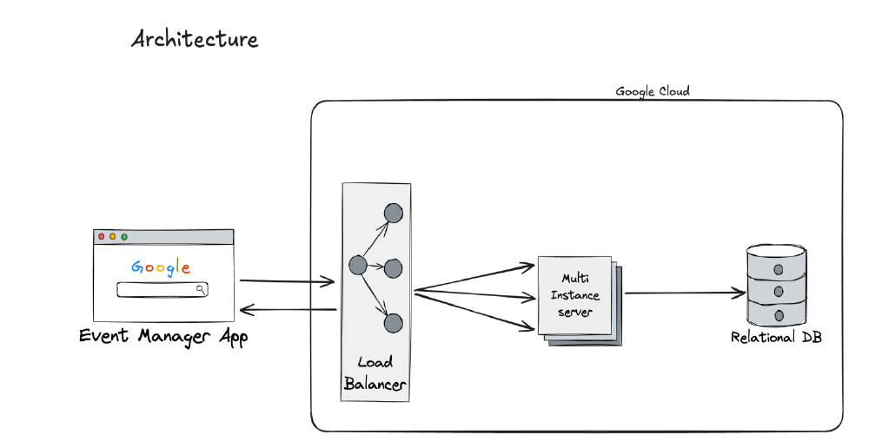
Architecture Diagram

Slide 7
Architectural Patterns
Patterns Used
Model-View-Controller (MVC) for organizing data flow
Repository Pattern: For data access abstraction
Comparison of Architectural Patterns
MVC:
Clear separation of concerns
Simple for handling request-response cycle
Repository Pattern:
Promotes loose coupling between business logic and data storage
Easier to test and maintain
MVC is better for straightforward, user-facing services
Repository Pattern enhances maintainability, particularly for data-driven systems

Slide 8
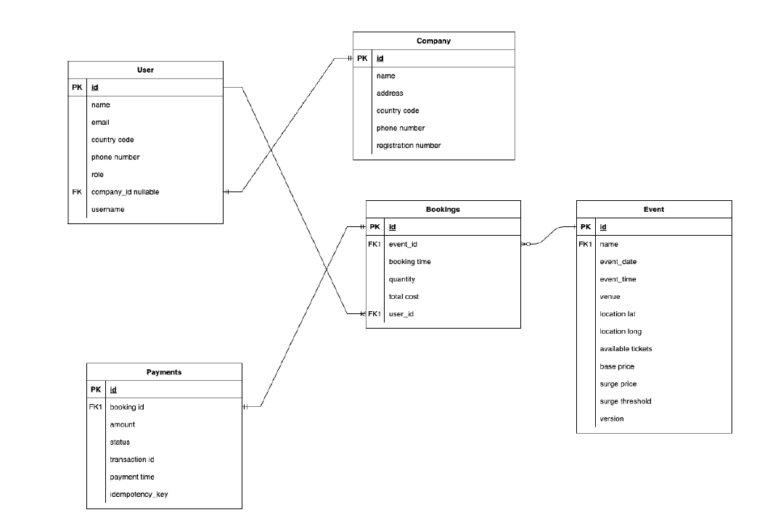
Class Diagram

Slide 9
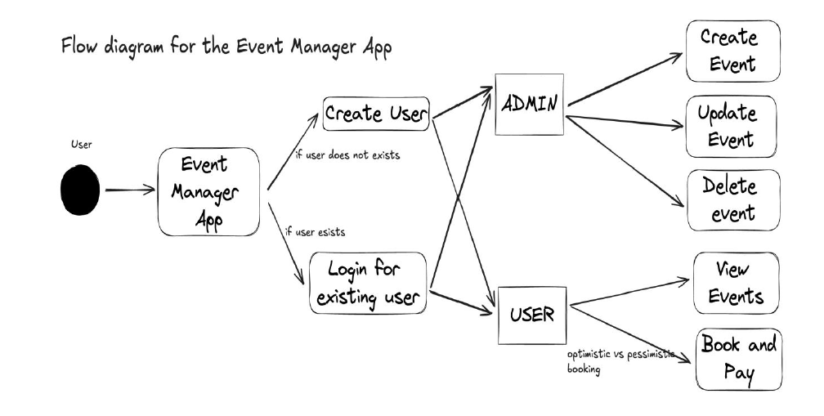
Flow Diagram

Slide 10
Cloud Computing Focus Areas
Scalability:
Implemented auto-scaling to handle increasing user loads
Load balancing across multiple servers
Fault Tolerance:
Resilient architecture with built-in redundancy
Modular Design:
Containerization for isolated, scalable services
Multi-Tenancy:
Optimistic Locking to prevent conflicting updates
Secure system allowing multiple event organizers and attendees to interact on the same platform

Slide 11
Thank You

